Slide 1
Module II
Data base design

Slide 2
NORMALIZATION
Normalization is the process of efficiently organizing data in a database.
E.F Codd proposed the concept of normalization.
Normalization removes redundant data from the tables to improve the storage efficiency ,data integrity and scalability.

Slide 3
Need for normalization
Normalization is the process of converting a relation into a standard form.
The problem in an unnormalized relation are as follows:-
Data redundancy
Update anomalies
Deletion anomalies
Insertion anomalies

Slide 4
Need for normalization
Data redundancy:-
In an unnormalizaed table design some information may be stored repeatedly.
In the below example ,student table the branch information ,hod, office telephone number is repeated.
This information is known as redundant data.

Slide 5


Slide 6
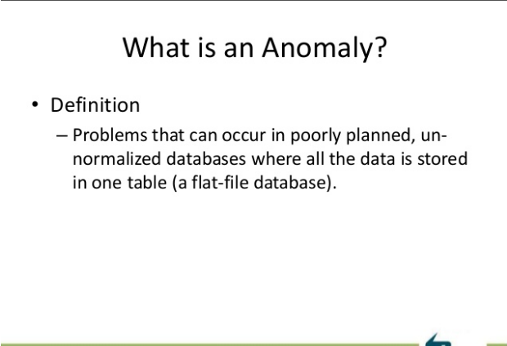

Slide 7
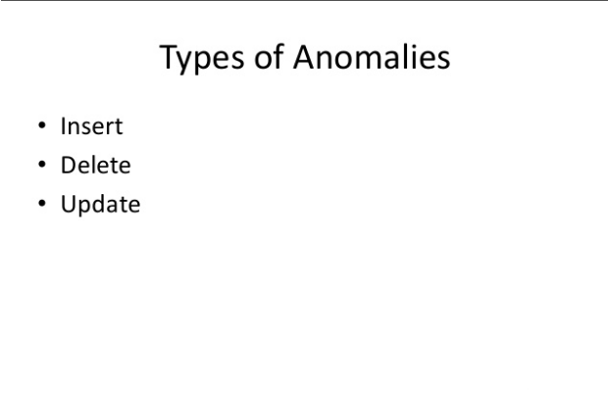

Slide 8
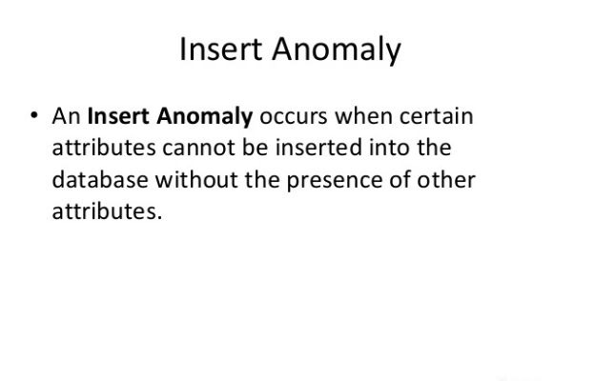

Slide 9


Slide 10
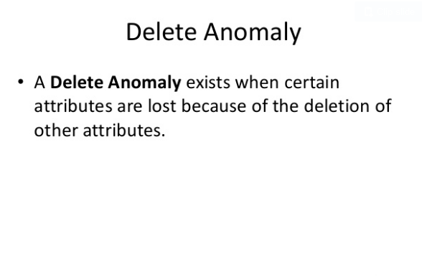

Slide 11
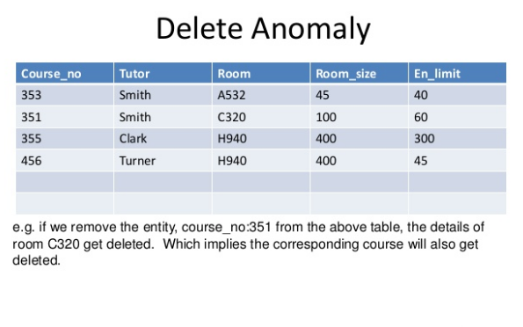

Slide 12
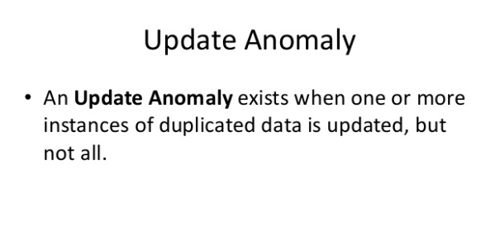

Slide 13


Slide 14
Functional Dependency
A functional dependency (FD) is a relationship between two attributes, typically between the PK and other non-key attributes within a table.
For any relation R, attribute Y is functionally dependent on attribute X (usually the PK), if for every valid instance of X, that value of X uniquely determines the value of Y.
This relationship is indicated by the representation below :
X ———–> Y

Slide 15
The left side of the above FD diagram is called the determinant, and the right side is the dependent.
SIN ———-> Name, Address, Birthdate
SIN determines Name, Address and Birthdate.
SIN, Course ———> DateCompleted
SIN and Course determine the date completed (DateCompleted). This must also work for a composite PK.

Slide 16
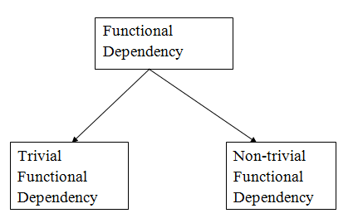
Types of Functional dependency

Slide 17
1. Trivial functional dependency
A → B has trivial functional dependency if B is a subset of A.
Consider a table with two columns Employee_Id and Employee_Name.
{Employee_id, Employee_Name} → Employee_Id is a trivial functional dependency as
Employee_Id is a subset of {Employee_Id, Employee_Name}.

Slide 18
2. Non-trivial functional dependency
A → B has a non-trivial functional dependency if B is not a subset of A.
When A intersection B is NULL, then A → B is called as complete non-trivial.
ID → Name

Slide 19

Inference Rules
Armstrong’s axioms are a set of inference rules used to infer all the functional dependencies on a relational database.
They were developed by William W. Armstrong.
Axiom of reflexivity
This axiom says, if Y is a subset of X, then X determines Y

Slide 20

Axiom of augmentation
The axiom of augmentation, also known as a partial dependency, says if X determines Y, then XZ determines YZ for any Z
prime and non-prime attributes
attributes of candidate key, are called prime attributes. And rest of the attributes of the relation are non prime.

Slide 21
Axiom of transitivity
The axiom of transitivity says if X determines Y, and Y determines Z, then X must also determine Z

Slide 22
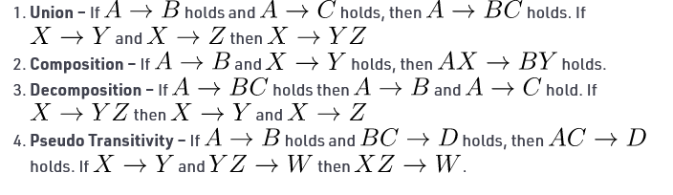
Secondary Rules –
These rules can be derived from the axioms.

Slide 23
Functional Dependency Set
Functional Dependency set or FD set of a relation is the set of all FDs present in the relation.
{ STUD_NO->STUD_NAME, STUD_NO->STUD_PHONE, STUD_NO->STUD_STATE, STUD_NO->STUD_COUNTRY, STUD_NO -> STUD_AGE, STUD_STATE->STUD_COUNTRY }

Slide 24
Attribute Closure:
Attribute closure of an attribute set can be defined as set of attributes which can be functionally determined from it.
To find attribute closure of an attribute set:
Add elements of attribute set to the result set.
Recursively add elements to the result set which can be functionally determined from the elements of the result set

Slide 25
If attribute closure of an attribute set contains all attributes of relation, the attribute set will be super key of the relation.
Question 1:
Given relational schema R( P Q R S T) having following attributes P Q R S and T, also there is a set of functional dependency denoted by FD = { P->QR, RS->T, Q->S, T-> P }.
Determine Closure of ( T )⁺

Slide 26
FD = { P->QR, RS->T, Q->S, T-> P }.
T+={ T,P,Q,R,S,T}

Slide 27
Consider the relation scheme R = {E, F, G, H, I, J, K, L, M, N} and the set of functional dependencies {{E, F} -> {G}, {F} -> {I, J}, {E, H} -> {K, L}, K -> {M}, L -> {N} on R. What is the key for R?
A. {E, F} B. {E, F, H} C. {E}

Slide 28
{{E, F} -> {G}, {F} -> {I, J}, {E, H} -> {K, L}, K -> {M}, L -> {N}
{E, F}+={ E,F,G,I,J}
{E, F, H}+={E,F,H,G,I,J,K,L,M,N }
{E}+={ E}

Slide 29
Canonical Cover of Functional Dependencies/Minimal set of Functional dependency
A canonical cover of a set of functional dependencies F is a simplified set of functional dependencies that has the same closure as the original set F.
Extraneous attributes: An attribute of a functional dependency is said to be extraneous if we can remove it without changing the closure of the set of functional dependencies.

Slide 30
A canonical cover F_{c} of a set of functional dependencies F such that ALL the following properties are satisfied:
F logically implies all dependencies in F_{c} .
F_{c} logically implies all dependencies in F.
No functional dependency in contains an extraneous attribute.
Each left side of a functional dependency in Fc is unique.

Slide 31
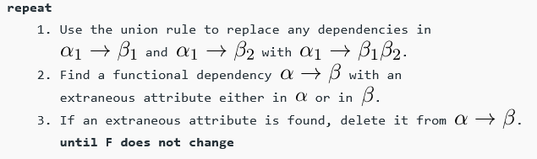
Finding Canonical Cover

Slide 32
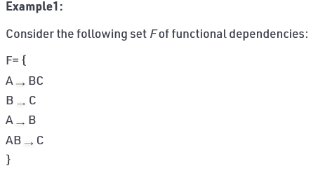
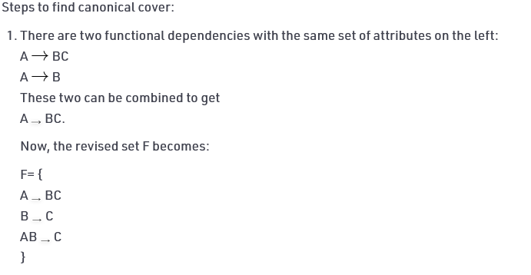

Slide 33
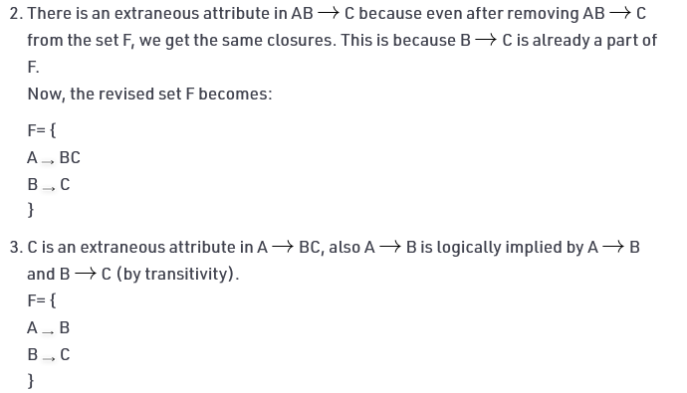

Slide 34


Slide 35
Let F = {A → B, A → C, BC → D}. Can A determine D uniquely?

Slide 36
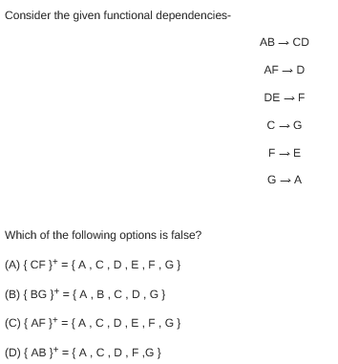

Slide 37
Consider a relation scheme R = (A, B, C, D, E, H) on which the following functional dependencies hold: {A–>B, BC–> D, E–>C, D–>A}. What are the candidate keys of R? [GATE 2005] (a) AE, BE (b) AE, BE, DE (c) AEH, BEH, BCH (d) AEH, BEH, DEH

